Slide 1
C#, OOP & Solid & Design patterns, LINQ, EF
By. Ahmed Mohamed Samir

Slide 2
C#

Slide 3
what's difference between C and C++
In Both C, C++ the written code is compiled into machine code and packaged into an executable file (EXE)
C++
Support OOP while C is not
Compile-time: the period when the source code is being converted into machine code by the compiler
Occurs when you press build
Run-time: the period when the compiled program is actually running

Slide 4
what's the limitation of C and C++ that makes Microsoft wants new programming language (C#)
Memory Management: The developer who need to free the dynamic allocation This can lead to common issues such as memory leakage
Creating GUI Application is so difficult
Cross-Platform Compatibility: the generated output EXE will run only for windows not for all platforms like Linux, MacOS

Slide 5
The compilation process of C# or any language of the .NET family
The source code written in C# is compiled by the C# compiler into Intermediate Language (IL) code
IL: is an intermediate language like assembly language but is designed to be platform-independent
The generated initial IL contains calls to helper methods and calls to methods defined in BCL
The CLR links the methods called in (IL) code with their implementations in (BCL)
JIT: tool existed on client machine that responsible for converting IL to 0/1 (machine code )
there is different types of JIT each one for different operating systems for example JIT for window that will convert IL to 0/1 that window can understand and so on
CLR [common language run] :
JIT [Just in Time] : one of CLR component
BCL [ base class library ] :

Slide 6
what is the difference between .NET framework and .NET core
.NET Framework
Runs primarily on Windows
.NET Core
Cross-platform: runs on Windows, macOS, and Linux.

Slide 7
publish
Right-click your project in Solution Explorer and select Publish.
Select Folder as the target and click Finish.
On the Publish tab, click Show all settings.
On the Publish tab, click Show all settings.
On the Publish tab, click Show all settings you could
Change Deployment Mode to:
Framework-dependent: Smaller size, but requires .NET to be installed on the target PC.
Self-contained: Larger size but runs on any PC without needing .NET installed.
Click Publish.

Slide 8
Files of publishing
[AppName].exe The main executable. This is what you (or your users) double-click to run the app.
[AppName].dll: The core logic of your application. In "Framework-dependent" mode, the .exe is just a launcher that calls this .dll , You can also run it manually using dotnet [AppName].dll.
[AppName].runtimeconfig.json: Critical file. It tells the computer which version of the .NET runtime (like .NET 8 or 9) is required to run your code. Without this, the app may fail to start.
appsettings.json (if used): This is where your configuration (like database strings or API keys) lives. If you change this file after publishing, the app will use the new settings without needing a re-compile.
[AppName].deps.json: A map of all your technical dependencies. It tells the app where to find any NuGet packages or other libraries it needs to function.
[AppName].pdb: Debugging symbols. These are not required for the app to run. You can delete them for a cleaner distribution, but keep them if you need to investigate "crashes" later using a debugger.
If you published "Framework-Dependent": You must give them everything in the publish folder (except the .pdb files)
If you published "Single-File": You only need to give them the one .exe file.

Slide 9
datatypes

Slide 10
Data Type
Integral numeric types
sbyte x // 1 byte [ -128 to 127 ], byte the largest num can carry is 2^8 – 1 = 255
short // 2 bytes , ushort the largest num can carry is 2^14 – 1
int x // 4 bytes , uint
long x // 8 bytes , ulong → 0 to 18,446,744,073,709,551,615
floating point numeric types
float // 4 bytes
double // 8 bytes
decimal // 16 bytes , used with money
char : 1 byte
string : immutable [once created can’t changed]
int, double, float, char are implemented as struct
String implemented as a class

Slide 11
Data-types [cont.]
datatypes in C# are divided into 2 categories
Value datatype
Primitive types: stores single simple value like int, long, char
Struct, Enum
equal operator : deep copy
Reference datatype
Classes, string, object, array
equal operator : shallow copy

Slide 12
string
String Range Syntax → [..number]
Example: string val = "123456789"; string res = val[..4] // res = "1234"
IndexOfAny
text.IndexOfAny(specialChars)
return -1 if the text does not contain any char of special chars array
It returns the zero-based index (the position) of the first match.

Slide 13
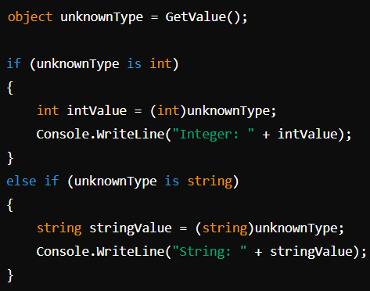
object
reference datatype
It’s the base (root) type for all C# data-types whether it is value DT or reference DT so it can carry any value
I need casting to make operations on the stored value
need boxing and unboxing to assign and retrieve value DT to object because I store the value DT on heap which means storing useless additional info
object obj = 5; // Boxing (value wrapped inside an object on the heap)
int x = (int)obj; // Unboxing (from heap to stack)
Useful for scenarios when you don't know the exact type until runtime
object obj = 2; // obj doesn't see 2 as integer , which means
you can't preform any operation of int on it , like obj++ // compile

Slide 14
Object DT (cont.)
all DT and user defined DTs inherit from ( object class ) that exists in system namespace
the methods defined in System.object class are
toString();
Equals();
GetType();
getHashCode(); // hash code used to determine where to store the object
Equals();
the default behavior of Equals() is comparing the values of stack together as following
Complex c1 = new Complex(2 , 5);
Complex c2 = new Complex(2 , 5);
c1.Equals(c2);
if complex is a class : false as it compares the references of c1 , c2 // shallow Comparison
if complex is a struct: true as it compares the values of c1 , c2 // deep Comparison

Slide 15
Dynamic
Type checking is occurred in run-time not in compile time [bypass compile-time type checking]
you can assign a value of one type to a dynamic variable and later assign a value of a different type
does not require explicit casting. This is one of the main features that distinguishes dynamic from object
When you use a dynamic variable, the C# runtime handles the type resolution and any necessary casting for you
Its drawbacks: Incorrect Method Invocation
dynamic x = 55;
x++; // 56 , if x is object DT you can not perform it
x = "Ahmed"; // x = "Ahmed" // valid
x.NonExistentMethod(); // Runtime error: string does not contain a definition for NonExistentMethod

Slide 16
var [implicit type local variable]
Compiler can identify the DT from right-hand side expression
Type checking is done at compile time
Used when I want to make the writing of code is easier [make complex type declarations easier]
var x; // compile must be initialized
var x = 132;

Slide 17
mutable and immutable datatype
mutable data-type:
In C#, a mutable data type refers to a data type whose instances can be modified after they are created
immutable data types cannot be modified once they are created [once created can not changed] like string

Slide 18
anonymous object
Immutable DT
it's an object without DT [class]
to define anonymous object-> var + new + object initializer
var obj = new {num=5, name="ahmed"};
obj.num = 55; // compile , it’s an immutable DT once you create object from it you can't make any changes on the data
var obj1 = new { s.id, s.fname }; // it will make the properties name with id , fname
var obj1 = new { s.id++ } // compile: once you make operation on value you must specify a name for property

Slide 19
object-initializer
used when i want to use the property during initializing object
it calls constructor first
student s = new student { id = 1, name = "ali" };
class student{
public int id { get; init; } // this property can be only set in initialization
public string fname { get; init; } // this property can be only set in initialization
}
student s = new student{ id = 1, fname = "ali" };
s.id = 56 // xxx compile error the id of student can only be assigned in object initializer
- you can force the user to use the object initializer
class student
{
public required int id { get; init; } // this property must be used when initializing object
public string fname { get; init; }
}
student s = new sudent(); // compile

Slide 20
Variable

Slide 21
Variable
int x; Console.Write(x); //compile error can't use unassigned variable
int x = 521; // the compiler always read the number on the right-hand side as an integer
long x = 521L; // L: it means suffix
double x = 521.55; // the compiler always read the decimal value on the right-hand side as a double
double x = 521.55D; // d for double
double x = 521.55d;
decimal num = 2.6645m //the compiler will read the decimal value on the right-hand side as decimal
decimal num = 2.6645M // M for money
int x = 1_000_000

Slide 22
Variable (cont.)
The reference DT can carry null
To make primitive DT carry null
int? x = null;
Nullable<int> x = null;
Ternary condition
int x = (5>2) ? 44 : 55;
Console.WriteLine(x); // x = 44
null coalescing operator
int? x = null;
int y = x ?? 100; if x equal null 100 will be returned
Console.WriteLine(y); // y = 100
null coalescing assign operator (??)
used to provide a default value when the expression on its left side evaluates to null
txt??="ahmed" // if text==null => text="ahmed”
null conditional operator
string name = person?.Name // if person is null returns null. If person is not null, it returns the value of Name
arr?.Length; // if array is not null retrieve its length
arr?[1]

Slide 23
IS , AS

Slide 24
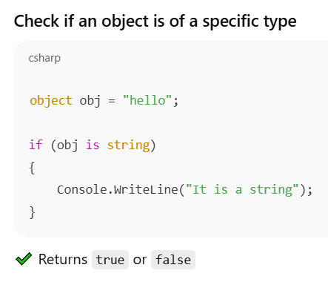
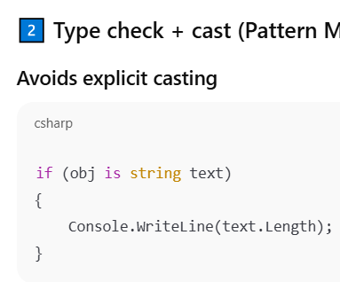
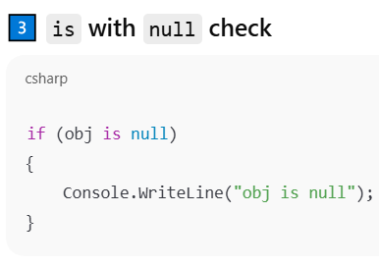
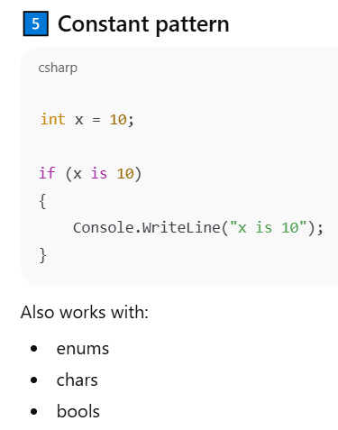
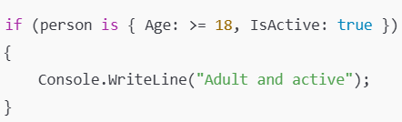
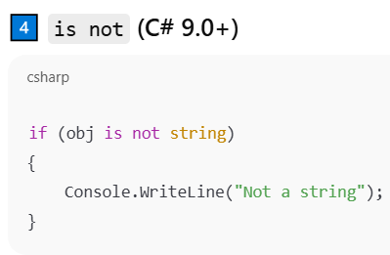
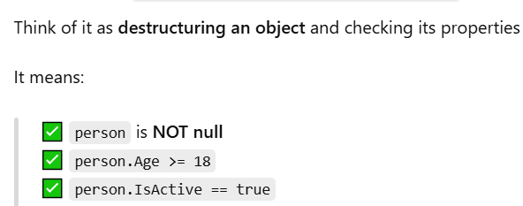
IS

Slide 25
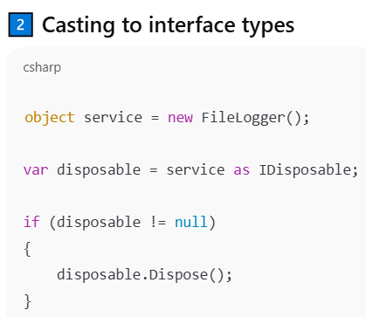
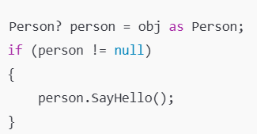

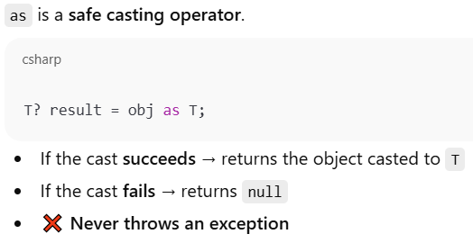
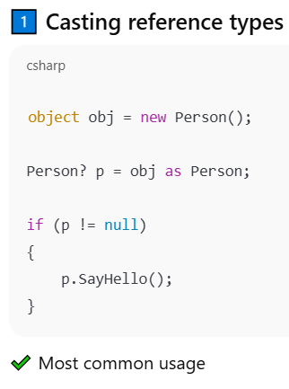
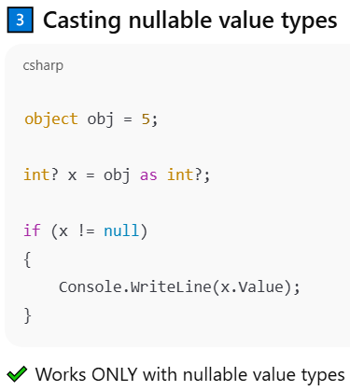
AS
works only with: Reference types, Nullable value types
It try to cast if fail returns null

Slide 26
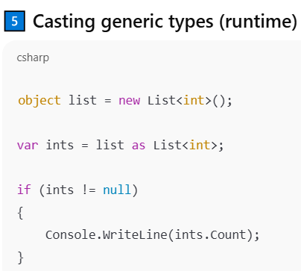
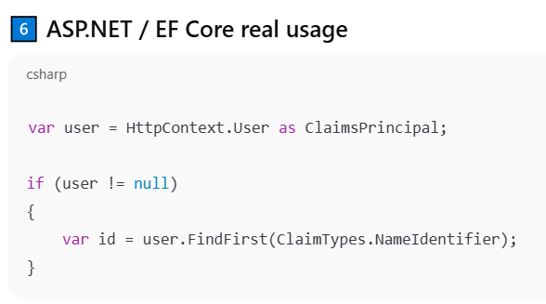
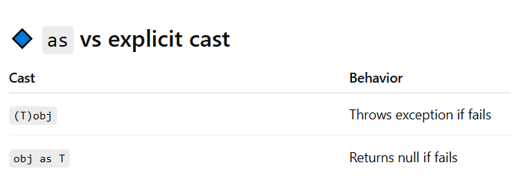
AS [Cont.]

Slide 27
Parameters

Slide 28
Ref parameter
ref parameter can not have a default value
ref parameters do not need to be the last parameters in a method
The variable passed as a ref argument must be initialized before it is passed to the method
static int operation(int x, int y , ref int sum) {
sum = x + y;
return x - y;
}
int sum; XX compile as ref variable must has a value before sent to method
int sum=0;
int sub = operation(12, 6, ref sum); // sum is passed by reference
Console.WriteLine($"sum={sum},sub={sub}"); // sum=18, sub=6
EX : this example shows how can reference allow us to return multiple values.
The ref keyword is placed before the argument name in the method call.
MethodName(ref parameterName: variable);

Slide 29
out parameter
out parameter can not have a default value
must assigned with value inside function so the Variable is not required to initialize the out argument before passing
it is similar to the reference-type used to return multiple values.
static int operation(int x, int y , out int num) {
num = x + y;
return x - y;
}
int sum;
int sub = operation(12, 6, out sum);
Console.WriteLine($"sum={sum},sub={sub}"); // sum=18, sub=6

Slide 30
Default param
Default parameters must come last

Slide 31
named parameter
named arguments must come after all positional arguments
DisplayPersonInfo("Alice", age: 30, city: "New York"); // Valid
DisplayPersonInfo(name: "Alice", 30, "New York"); // Invalid
The ref keyword is placed before the argument name in the method call.
MethodName(ref parameterName: variable);

Slide 32
Typeof
typeof(ShipmentType); return type
Console.WriteLine(typeof(int)); // System.Int32
Console.WriteLine(typeof(float)); // System.Single
Console.WriteLine(typeof(double)); // System.Double
Console.WriteLine(typeof(char)); // System.Char
Console.WriteLine(typeof(string)); // System.String
Console.WriteLine(typeof(Array)); // System.Array
Console.WriteLine(typeof(int[])); // System.Int32[]
Console.WriteLine(typeof(object)); // System.Object

Slide 33
LINQ

Slide 34
Extension method
It helps you by extending the functionality of existing types without modifying their source code or creating a new derived type
Syntax static class & static method and this before parameter
EX:
static class test{
public static int wordCount(this string text) // this method becomes extension method for DT string
{ return text.Split(" ").Length; }
}
string str = "ahmed mohamed samir";
int c = str.wordCount();
It’s like open for extension closed for modification principle
extension method must be defined in a non-generic static class

Slide 35
OPEN for extension closed for modification example
public abstract class Shape { public abstract double GetArea(); }
public class Circle : Shape
public double Radius { get; set; }
public override double GetArea() { return Math.PI * Radius * Radius; }
public class Rectangle : Shape
public double Width { get; set; }
public double Height { get; set; }
public override double GetArea() { return Width * Height; }
// violation of Open for extension
public class Square { getter , setter }
public class Rectangle { getter , setter }
public class DrawShape {
public void draw(Object shape){
if(shape is instance of Square)
// draw square
if(shape is instance of Rectangle)
// draw rectangle
}

Slide 36
delegate
Reference to method, can be instantiated and called directly like methods
delegate is a DT which means can be instantiated, this object refers to methods with the same signature
to define delegate
public delegate int myDel(int x, int y); // this means that delegate must refer to methods with signature int fun(int, int)
static int sum(int x , int y){ return x + y;}
to make an object from delegate
myDel del1 = new myDel(sum);
myDel del2 = sum; // syntax sugar
myDel del3 = (int x, int y) => x + y; // inline method
myDel del4= (x, y) { return x + y; }; // the most common used
myDel del5= delegate (int x, int y) { return x + y; }; // Anonymous method using delegate keyword
to invoke the delegate
int s = d.Invoke(5,6); // delegate invoking → passing parameters to its assigned methods and calling them
int s = d(5,6); // syntax sugar

Slide 37
Delegate continue
static int sum(int x , int y){ return x + y;}
delegate as a parameter
public void operation(int n1 , int n2, mydel d){ Console.WriteLine( d.Invoke(n1, n2));}
operation(5,6, sum)
multi-casting delegate
delegate can refer or point on more than one method
myDel del = new myDel(sum);
del+=sub // delegate also refers to sub method
del.Invoke(5,6) // it will execute the methods sum, sub, but it will return the returned value of last method executed, the method executed sequentially
del-=sum // remove the assigned method sub , if there is 2 of methods sum it will remove the last one added
myDel D = d1+d2 //where d1,d2 are another delegates, valid operation and D will have the (methods) of d1 and d2
myDel D = d1-d2 // all methods of d2 must be existed in d1 to allow subtraction operation else D will be equal d1

Slide 38
Delegate continue
Generic delegate
public delegate T mydel<T>(T x, T y);
mydel<int> d = sum;
Built in delegate
Func delegate: return value
public delegate TResult Func<in T1, out TResult>(T1 arg1);
Func<int, int, int> d1 = new Func<int, int, int>(sum);
Func<int, int, int> d2 = sum;
Func<int, int, int> d3 = delegate(int x, int y) { return x + y; };
Func<int, int, int> d4 = (int x, int y) => x + y;
Action delegate // return void
Predicate delegate // return bool

Slide 39
Func<int> getNumber = () => 42;
Here, Func<int> means: A function that returns int and takes no parameters.

Slide 40
Filter using delegate
public static student testFunc(Func<student, bool> filter){
return students.FirstOrDefault(filter);
}
testFunc(std => std.id == 5);
testFunc((student x) => x.id == 5);
testFunc(delegate (student std) { return std.id == 5; });
Very important note
Func<TEntity, bool>
This delegate cannot be translated into SQL Query, so EF return all records then the filtration applied on memory
Expression<Func<TEntity, bool>>
Can be converted into SQL. Entity Framework Core can translate this expression into SQL, so the filtration is done in DB

Slide 41
event
An event is a special kind of delegate
Used to notify multiple subscribers about certain actions or changes.
Events provide a layer of encapsulation over delegates
Events can only be invoked by the class that defines them
Delegates can be invoked directly from an external class
ensuring that only the event’s class can invoke the event, while external classes can only subscribe or unsubscribe from it.
you keep in mind:
[publisher, publisher method that fire(invoke) delegate, you need to ensure that delegate is not a null to prevent null reference exception],
[subscriber, function assigned to delegate by which notify the delegate invoking ]

Slide 42
Event example
public delegate void MyDelegate(string message);
public class Publisher
public event MyDelegate MyEvent;
public void RaiseEvent(string message) { MyEvent?.Invoke(message); } // Publisher method
public class Subscriber
public void OnEventRaised(string message) { Console.WriteLine("Event received: " + message); }
static void Main()
Publisher pub = new Publisher()
Subscriber sub = new Subscriber(); subscriber
pub.MyEvent += sub.OnEventRaised;
pub.RaiseEvent("Hello, Events!"); }

Slide 43
Built-in event
delegate void Eventhandler(object sender , eventargs e)
delegate void eventhandler<t>(object sender ,t e) // generic where t must be of type EventArgs
public class VideoEventArgs : EventArgs
public string Title { get; set; } public decimal Url { get; get; }
class MrBeast
public event EventHandler<VideoEventArgs> VideoUploaded;
public void UploadVideo (string title, decimal URL) { OnVideoUploaded( new VideoEventArgs(title, URL ) ); }
protected virtual void OnVideoUploaded( VideoEventArgs e ) { VideoUploaded?.Invoke(this, e); }
class Subscriber
public void OnVideoUploaded (object sender, VideoEventArgs e){ //code to notify that mrBeast publish video }
MrBeast mrBeast = new MrBeast(); // publisher
Subscriber subscriber1 = new Subscriber("Alice"); Subscriber subscriber2 = new Subscriber("Bob");
mrBeast.VideoUploaded += subscriber1.OnVideoUploaded;
mrBeast.VideoUploaded += subscriber2.OnVideoUploaded;
mrBeast.UploadVideo("Last to Leave Circle Wins $10,000", "https://youtu.be/abc456"); // Upload a video

Slide 44
To Ensure Unique Records per properties
Groupby( x=> new {x.title, x.address} ).Select(group => group.FirstOrDefault()).ToList()

Slide 46
Stateless operations
stateless operation
Functions that return the same result given the same inputs and have no side effects. For example, a function that adds two numbers: public int Add(int a, int b) { return a + b; }
Each invocation of a stateless service or method is independent and does not depend on any previous interactions.
Utility Services: designed to perform common, reusable tasks that are often needed across different parts of an application. these tasks are typically stateless and do not depend on the context or state of other operations like math operations, string manipulation.

Slide 47
the differences between synchronous and asynchronous
synchronous programming:
tasks are performed one after another. This means that the program waits for each task to complete before moving on to the next one
when a method is called, the program will block and wait until that method has completed
Asynchronous Programming
allows tasks to be performed concurrently
return type of async method must be Task or Task<T>
Await: Used to wait for an asynchronous operations to complete without blocking the calling thread so The program doesn't block while waiting for the task to complete, must be used within async method
method with name func1 return → Task<string> to call it
the current method should be async that must be Task or Task<T>
string res = await func1()
Return a Task: when Asynchronous method called Immediately after initiating the operation, the method returns a Task to the caller, allowing the caller to continue executing without waiting for the database operation to complete.

Slide 48
Asynchronous example
public async Task ProcessOrderAsync(Order order)
{
ValidateOrder(order); // Validate the order details (this can remain synchronous).
await SaveOrderToDatabaseAsync(order); // 2. Save the order asynchronously.
var warehouseNotificationTask = NotifyWarehouseAsync(order); // Notify the warehouse asynchronously.
var emailTask = SendConfirmationEmailAsync(order.Customer); // Send a confirmation email asynchronously.
await Task.WhenAll(warehouseNotificationTask, emailTask); // Await both tasks to complete.
}
Note : you can use ContinueWith with WhenAll
Task.WhenAll(t1,t2).ContinueWith(()=>{});

Slide 49
Asynchronous example
var allGamesTask = gameService.getAllGames();
var allLocationsTask = locationService.getAllLocations();
await Task.WhenAll(allGamesTask, allLocationsTask); // Await the completion of both tasks
var allGames = await allGamesTask;
var allLocations = await allLocationsTask;
Note: InvalidOperationException you're attempting to perform multiple operations concurrently on the same DbContext
Entity Framework Core does not support multiple concurrent operations on the same DbContext instance
The solution: because you need read-only operations you can use AsNoTracking which is a method that tells the Entity Framework context not to track changes to the entities retrieved from the database, so it’s used to optimize read-only queries.
OR you can make Different DBContext for each repository but it’s not good for data consistency

Slide 50
Asynchronous methods
Task.Run()
commonly used to perform computationally intensive or background operations asynchronously without blocking the main thread.

Slide 51
Logs
Logs" or "logging" refer to the process of recording events, messages, or other information generated by a computer program or system during its operation. Logging is a crucial aspect of software development and system administration because it provides a way to track the behavior of applications, diagnose issues, and monitor system performance.

Slide 52
AddScoped(), AddSingleton(), and AddTransient()
AddScoped()
one instance of the service is created per request level and used for each service injection
EX: "Database Context" You want all data operations in a single web request to use the same database context for consistency, single Context ensuring that all database operations performed within that context are part of a single transaction. This helps maintain data consistency and integrity.
AddSingleton() A single instance of the service is created and shared throughout the application's lifetime. The same instance is used for every request and service injection
Ex: Logging Service you want a single instance of the logger shared across the entire application to keep logging consistent.
AddTransient()
Create instance of the service for each service injection
EX: stateless service like Email Service , because each email sending operation is independent

Slide 53
Handling Exception

Slide 54
Common Built-in Exceptions
Common Built-in Exceptions
NullReferenceException: Thrown when you try to access a member on a null
ArgumentNullException: Thrown when a null argument is passed to a method that does not accept it.
ArgumentOutOfRangeException: Thrown when an argument's value is outside the acceptable range of values defined by the method

Slide 56
OOP

Slide 57
Class
default access modifier in class is private
constructor with class: there is a default (parameterless) constructor generated automatically that used to initialize class fields with default values in case of you don’t have any another constructors
once you make parameterized constructor you need to override the parameterless constructor if you want to use it
at IL file parameterless constructor could not exist

Slide 58
Encapsulation
bundle data (fields and methods (operations on fields)) into a single unit known as a class. where you can determine accessibility(scope) of each part of code using access modifiers
encapsulation is used to restrict direct access to some of an object's components, which can prevent the accidental modification of data. This is typically achieved through access modifiers
Access modifier

Slide 59
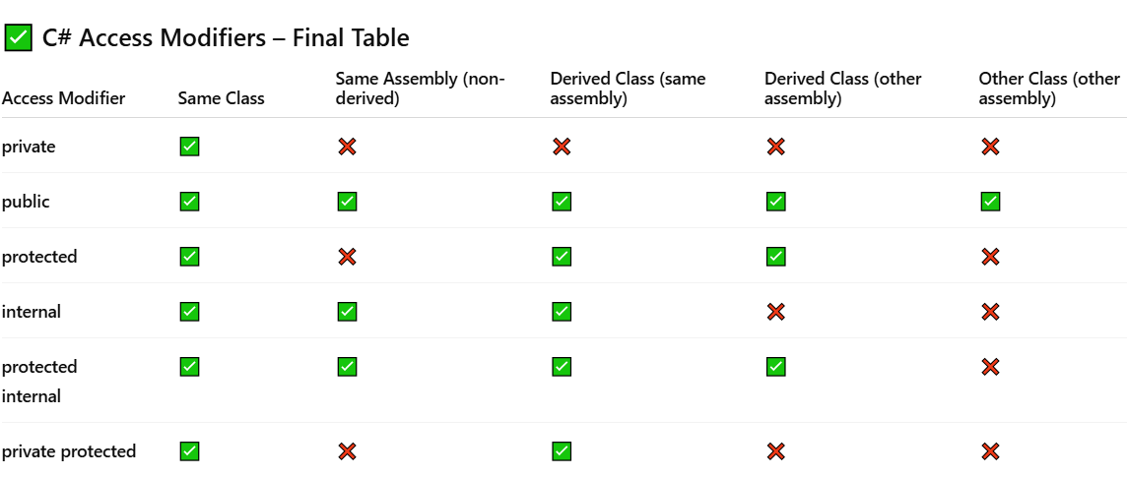
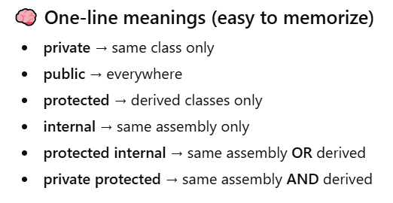
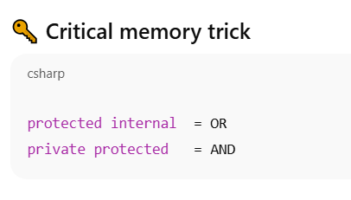
Access Modifiers

Slide 60
Polymorphism
Polymorphism in general allows us to perform more than implementation to method
ال Polymorphism in general بيسمحلنا اننا نعمل اكتر من implementation لنفس ال method
Polymorphism is divided into two types:
Compile-Polymorphism (static) : overloading → class with more than method name
Run-time Polymorphism :
refers to the ability of different objects to respond to the same method call in different ways.
It allows methods to do different behavior based on the object
ان يكون للmethod الواحدة اكتر من behavior وده based على ال object اللى هيعمل call لل method

Slide 61
Inheritance
the child inherits all members within the parent except the constructor and destructor
The constructor of child class always calls the constructor of parent class implicitly or explicitly and it’s by default call the parent default constructor
you can determine explicitly which parent constructor will be called with child constructor using base keyword
C# supports single inheritance only
public class Parent
{
public int x { get; set; }
public int y { get; set; }
public Parent() { }
public Parent(int _x, int _y)
{
x = _x;
y = _y;
}
}
public void test() {
Console.WriteLine("hello from test");
}
base keyword can access any member of parent member if that member is not private
base.parentMemeber
base.test();
public class Child:Parent
{
int z;
public Child(int _x, int _y, int _z) : base(_x, _y)
{
this.z = _z;
}
}

Slide 62
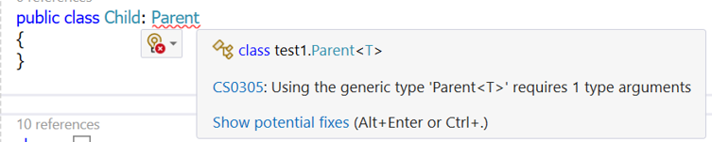
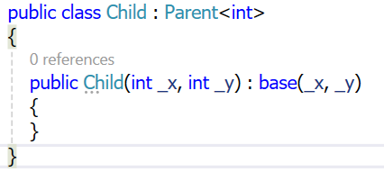
Inherit from generic
public class Parent<T>
{
public T X { get; set; }
public T Y { get; set; }
public Parent(T _x, T _y)
{
X = _x;
Y = _y;
}
}
you need to provide a type argument T for the Child class when inheriting from the Parent<T> class. Here's the corrected version of the code:

Slide 63
Abstraction
definition
Template or rules for other classes to follow
class made for other classes to Inherit prop & methods from it
allows you to hide the complex implementation details
Abstract class
can not be instantiated
can has an abstract method and non abstract method
abstract method
(function without body) must be override in a subclass
You are not allowed to declare the abstract methods outside the abstract class.

Slide 64
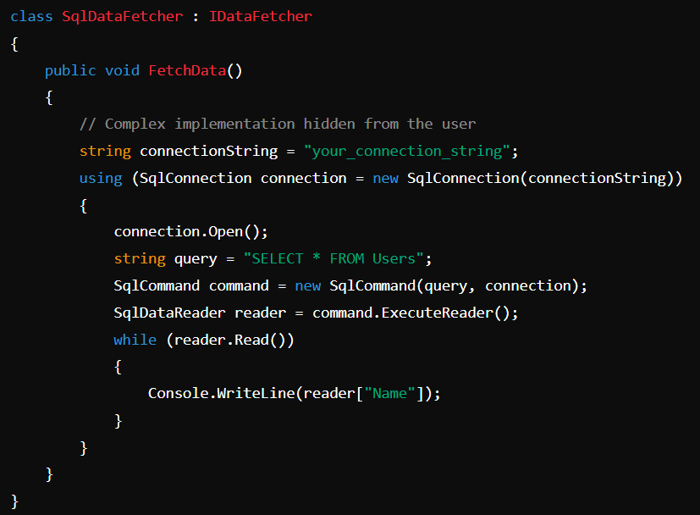
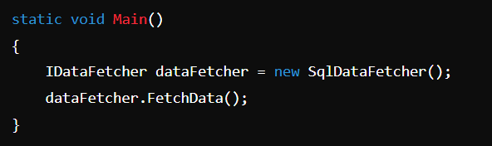
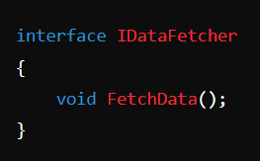
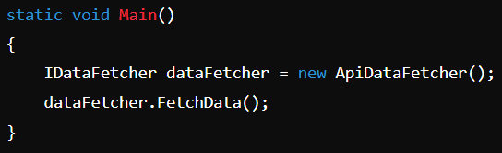
Example of how abstraction hide the complex implementation details
The client code interacts with IDataFetcher, not directly with SqlDataFetcher.
You can also implement class → ApiDataFetcher : IDataFetcher

Slide 65
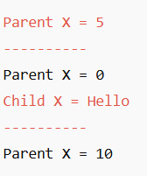
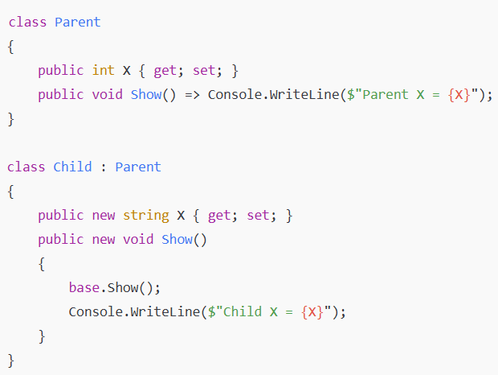
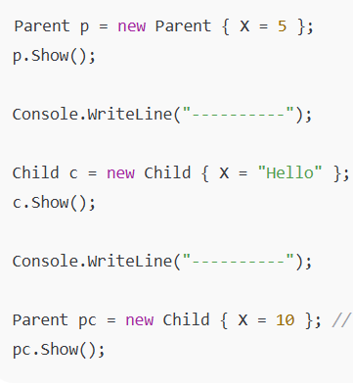
new keyword
Used to hide a member from the base class that has the same name.
Both parent and child versions exist in memory; the compiler just decides which one to call based on reference type.
At the third one : The reference is declared as Parent, so the compiler sees pc as a Parent variable That means:
Only the Parent’s members are visible at compile time.
The compiler doesn’t even know the object is a Child yet (until runtime).
You can still access parent’s hidden members using base
If you omit new, the compiler warns: “Hides inherited member — use the new keyword if hiding was intended.”

Slide 66
new keyword (cont.)
new breaks (Prevent ) virtuality chain (i.e., even if base is virtual, new stops overriding behavior).
class Parent { public virtual void Show() => Console.WriteLine("Parent show"); }
class Child : Parent { public new void Show() => Console.WriteLine("Child show"); //new here breaks the virtual chain }
class SubChild : Child { public new void Show() => Console.WriteLine("SubChild show"); }
Parent p1 = new Parent(); p1.Show(); // Parent show
Parent p2 = new Child(); p2.Show(); // Parent show
Parent p3 = new SubChild(); p3.Show(); // Parent show
------------------------------------------------------------------------------------------------------------------------------------------------------------

Slide 67
Virtual & Override
Override keyword used to extend virtuality ( most derived override available )
class Parent { public virtual void Show() => Console.WriteLine("Parent"); }
class Child : Parent { public override void Show() => Console.WriteLine("Child"); }
class GrandChild : Child { public override void Show() => Console.WriteLine("GrandChild"); }
Parent obj = new GrandChild(); obj.Show(); // GrandChild
-----------------------------------------------------------------------------------------------------------
class Parent { public virtual void show() { Console.WriteLine($"parent show "); } }
class Child : Parent { public override void show() { Console.WriteLine($"child show "); } }
class SubChild : Child { public new void show() { Console.WriteLine($"Sub child show "); }
Parent p1 = new Parent(); p1.show(); // parent show
Parent p2 = new Child(); p2.show(); // child show
Parent p3 = new SubChild(); p3.show(); // child show
--------------------------------------------------------------------------------------------------------------------------------------------------------
class Parent { public virtual void Show() => Console.WriteLine("Parent show"); }
class Child : Parent { public virtual void Show() => Console.WriteLine("Child show"); // ❌ Hides Parent.Show }

Slide 68
Sealed
sealed with class → sealed class Parent { } // ❌ Cannot be inherited but can be instantiated
sealed with method → public sealed override void show(){} // this class will extend the virtuality but the child of this class can't extend the virtuality of method show()
sealed virtual: compile error : how on earth you want to do something like that
sealed keyword : class will extend the virtuality of method but the child of this class can't extend the virtuality of the method
new keyword : class can't extend the virtuality of method and child of this class also can't extend the virtuality of the method

Slide 69
interface
It is a contract for what a class can do
عبارة عن contract لل operations اللى ال class لازم يحققها
it's a contract must be achieved , class A is a type of A -> if class A implements members of type A
the default of methods within interface is abstract
Members default access modifiers is public
Support multiple inheritance: class can implement more than one interface
interface can't be instantiated
interface can't contain fields, but it can contain automatic property, and you must implement this property as well
you can write a method with body [default implementation] within interface and the class that inherits this interface will has a copy of this method and in this case, you don't have to implement this method
if class implements many interfaces and all these interfaces have a method show, you will need to implement show method only once
class Test : Parent, TypeA, TypeB // inherit comes first then implement

Slide 70
Built-in Interface [IDisposable]
IDisposable interface → need to implement Dispose()
It is used to release(manage) unmanaged resources such as database connection and opened files
any object you wrap inside a using statement must implement the IDisposable interface why ?
Because the using statement works like this behind the scenes:
try { Your code }
finally { if (resource != null) resource.Dispose(); }
Note that Dispose() is called even if an exception occurs
using statement-> making(limit) a scope to object and call Dispose() at the end of scope provided that this object is type of IDisposable so we need to make the class object implements IDisposable

Slide 71
Built-in Interface [IDisposable] cont.
using (var file = new FileStream("file.txt", FileMode.OpenOrCreate)) { } // Dispose() is called at the end of using block
using var file = new FileStream("file.txt", FileMode.OpenOrCreate) // Dispose() is called at the end scope
What Dispose() Does
Closes file handles, network connections, database connections, or streams.
No, you don’t need to implement what happens in Dispose() for FileStream. That’s because: FileStream already implements IDisposable and provides a proper Dispose() method that closes the handle and cleans up resources.
You only implement Dispose() yourself if you are creating your own class that holds unmanaged resources

Slide 72
SOLID

Slide 73
SOLID (cont.)
SOLID is five principles of object-oriented design to make software easier to maintain and extend
S — Single Responsibility Principle (SRP)
O — Open/Closed Principle (OCP)
L — Liskov Substitution Principle (LSP)
I — Interface Segregation Principle (ISP)
D — Dependency Inversion Principle (DIP)

Slide 74
Single Responsibility Principle (SRP) A class should have one reason to change.
it’s not mandatory for a class to have only one method to satisfy the Single Responsibility Principle (SRP).
all methods of class collectively serve one cohesive responsibility.
public class InvoicePrinter { public void Print(Invoice invoice) { /* printing logic */ } }
public class InvoiceSaver { public void Save(Invoice invoice) { /* save to DB */ } }
Why it's good: Each class has a single job. Changes in printing won’t affect saving logic.
public class EmailSender { public void SendEmail(string to, string subject, string body) { /*...*/ } }
Why it's good: The class focuses only on sending emails. No unrelated responsibilities.

Slide 75
SRP (Bad Examples)
Example 1
public class InvoiceManager {
public void Print() { }
public void Save() { }
public void Email() { }
}
Why it's bad: One class handles multiple unrelated concerns. A change in one method could unintentionally impact others.
public class UserManager {
public void CreateUser() { }
public void SendWelcomeEmail() { }
public void GenerateReport() { }
}

Slide 76
O: open for extension closed for modification Ex1
public class Square { getter , setter }
public class Rectangle { getter , setter }
public class ShapePrinter {
public void drawShape(Object shape){
if(shape is instance of Square)
// draw square
if(shape is instance of Rectangle)
// draw rectangle
}
open closed principle executed by abstraction and Polymorphism
public abstract class Shape{
abstract void draw();
}
public class Square extends Shape{
// getter , setter
public void draw(){ console.log("square") }
}
public class Rectangle extends Shape{
// getter , setter
public void draw(){console.log("Rectangle") }
}
public class ShapePrinter{
public void drawShape(Shape shape){ shape.draw();
}
}
this example violate the open closed principle as if we add a new class such a triangle we will
need to modify the method drawShape by adding
if(shape is instance of Triangle){ // draw triangle}

Slide 77
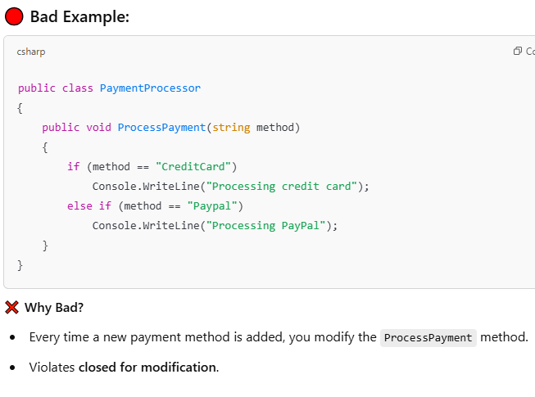
O: open for extension closed for modification Ex2
.

Slide 78
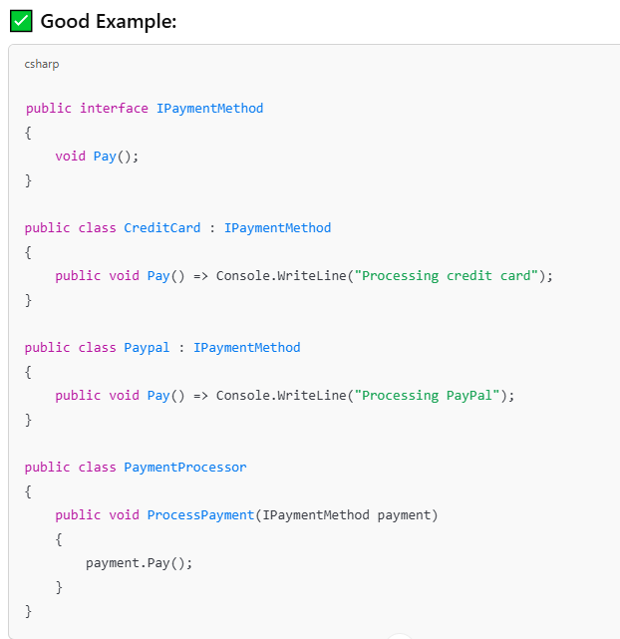
O: open for extension closed for modification Ex2 Sol
.

Slide 79
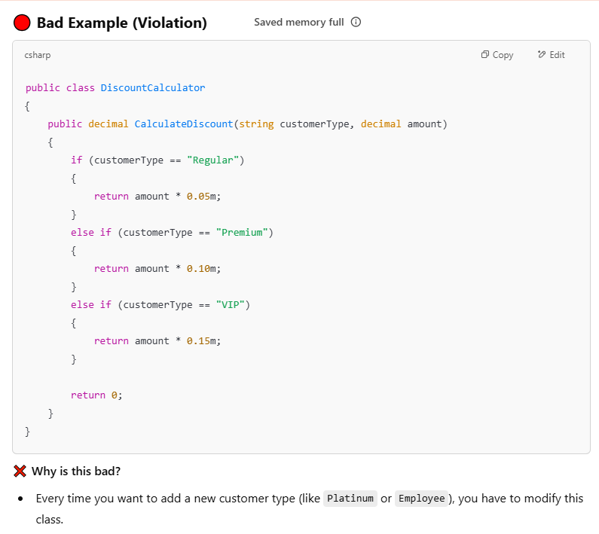
O: open for extension closed for modification (EX 3)

Slide 80
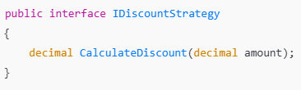
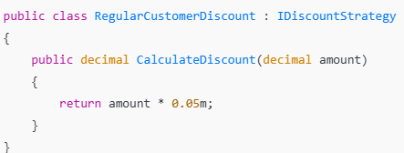
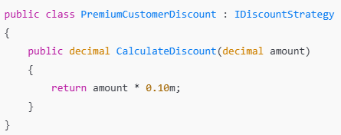
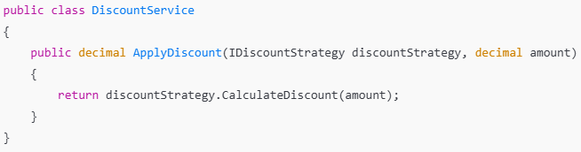
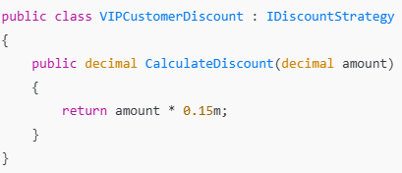
Solve the previous open for extension closed for modification (EX 3)

Slide 81
Liskov Substitution principle
A derived class should be able to replace its base class without changing the behavior of the program

Slide 82
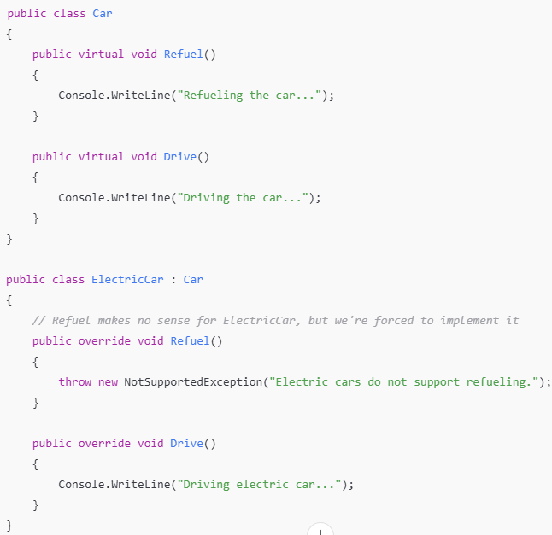
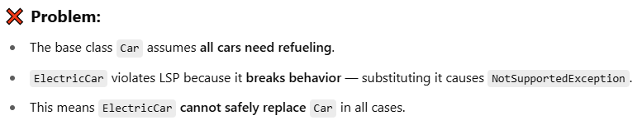
Liskov Substitution principle Ex1

Slide 83
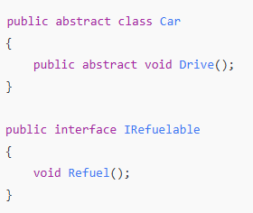
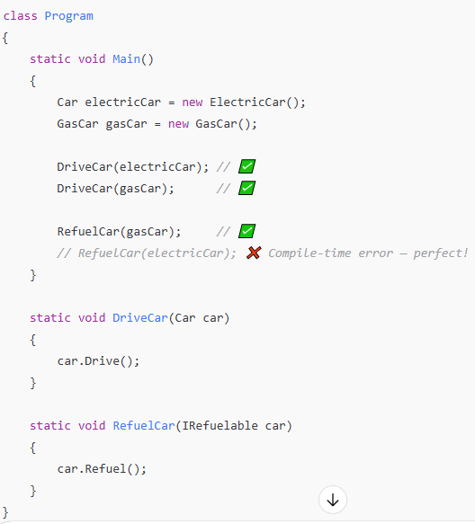
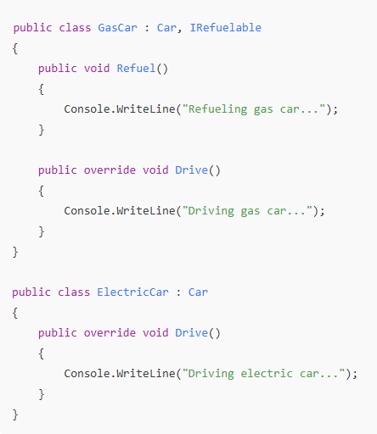
Liskov Substitution principal Ex1 Sol

Slide 84
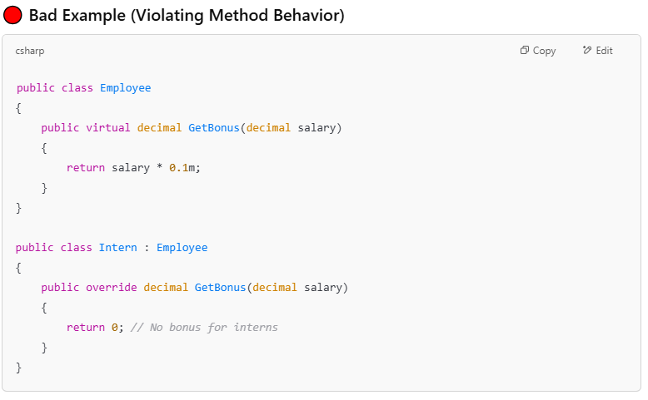
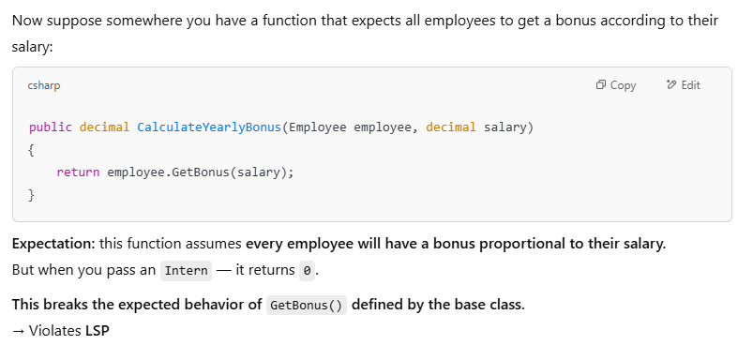
Liskov Substitution principal Ex2

Slide 85
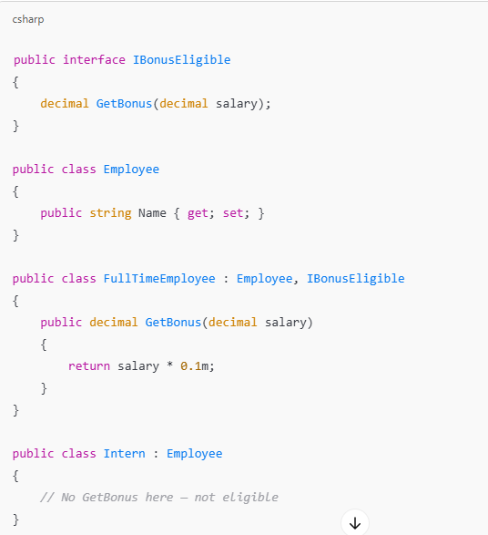
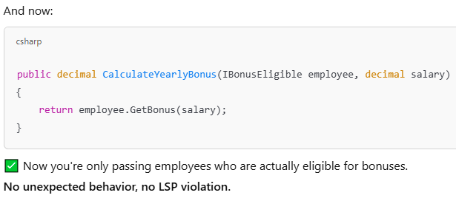
Liskov Substitution principal Ex2 sol

Slide 86
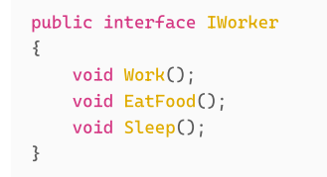
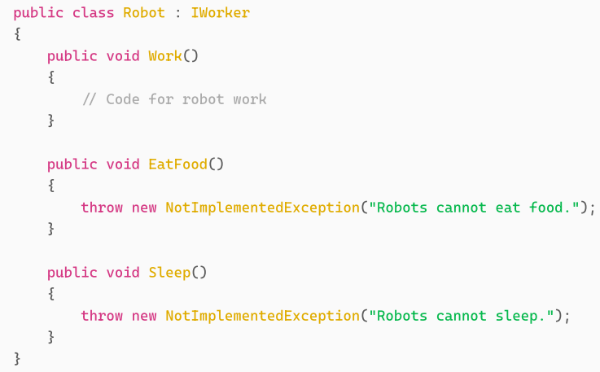
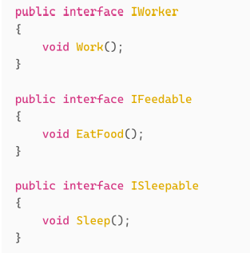
I: Interface segregation
The goal is to prevent the creation of "fat" interfaces that has more responsibilities than necessary,
For example, Instead of having a single monolithic interface with methods for example: loading, saving, formatting, printing, etc., it might be better to have separate interfaces like Loadable, Savable, Printable

Slide 87
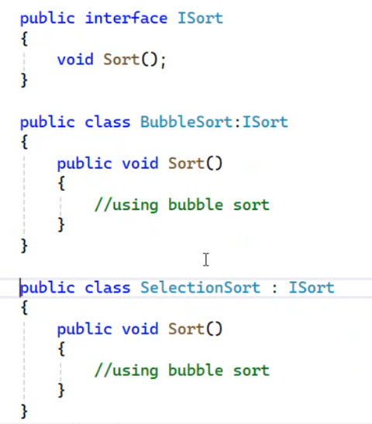
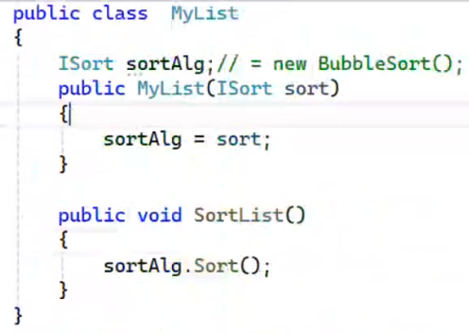

D: dependency inversion principle
Don’t make the high class depend on low level class Depend on Abstraction both should depend on abstractions
Here the class myList depend on the any class of type Isort and thus You can easily switch implementations easily without changing MyList Class
Here the MyList class depend on Bubble Sort class (tightly coupled)
Which violate the principle, tightly coupled is very hard in testing

Slide 89
IOC
Inversion of Control (IoC) is a design principle in software engineering where the control of object creation and lifecycle management is transferred from the application code to an external framework or container. In other words, rather than objects creating and managing their dependencies internally, these dependencies are provided externally

Slide 90
Dependency injection
a technique where an object's dependencies are provided from the outside class rather than created inside.
It helps in switching implementation, improve testability, follow the Dependency Inversion Principle of SOLID
builder.Services.AddScoped<IPaymentService, PaypalPaymentService>();
builder.Services.AddScoped<IPaymentService, CreditCardPaymentService>();
ASP.NET Core has IOC container that support DI using AddScoped, AddTransient, and AddSingleton.

Slide 91
Design Pattern

Slide 92
Design patterns types
Creational
Singleton
Factory Pattern
Behavioral
Template Method Pattern
Strategy pattern

Slide 93
Design pattern
Design patterns is a solutions (standards) for repetitive problems in software development
Creational: focuses on how objects are created in such away makes the system flexible and decoupled from the specific classes.
Singleton: create on object of class
factory
Structural: These patterns help ensure that if one part of a system changes, the entire system doesn’t need to change as a result.
Behavior: objects interact and communicate with each other

Slide 94
Factory Pattern
Creational Design Patterns
focus on how objects are created
It helps to encapsulate object creation so that your code becomes more flexible and adheres to the Open/Closed Principle

Slide 95

Example 1 using factory pattern (factory Method)

Slide 96







Example 1 (cont.)

Slide 97




Example 1 (cont.)

Slide 98






Get base data, get details on demand

Slide 99





Get base data, get details on demand (cont.)

Slide 100
Decorator pattern
it allows behavior to be added to individual objects, either statically or dynamically, without affecting the behavior of other objects from the same class.
Decorator pattern : for example, IS A Text and HAS A

Slide 101

Creational Design pattern (Singleton )
ensures that a class has only one instance throughout the application — and provides a global access point to that instance
When you need one and only one instance
Logging Service
DB Connection Manager
Caching System
Steps
Private static fieled to hold the instance
Private constructor to prevent external instantiation
The static method that provide access to instance
Example

Slide 102


Creational
Decorator pattern
Many inheritance is not a solution

Slide 103
Creational (Adapter)
The Adapter Pattern is a structural design pattern that allows objects with incompatible interfaces to collaborate.
it acts as a bridge between two incompatible interfaces, allowing them to work together seamlessly.
The primary problem that the Adapter Pattern solves is the need to integrate or use existing classes or interfaces that are incompatible with the rest of the system
Integrate with another systems
Take an object and modify it to cope with another system that will
تدخله اوبجيكت وتخرجه بشكل مختلف يتلاءم مع الطرف الاخر ( سيستم اخر )

Slide 104
Behavioral patterns: Strategy pattern
Enable selecting algorithm at the same time, instead of implementing one algorithm directly code receives at run-time instructions through which one of family algorithms will be used

Slide 105
Template Method Pattern
behavioral design pattern
Definition : defines the skeleton of an algorithm in a base class, but lets derived classes override specific steps without changing the algorithm's structure
When to use :
You have a fixed algorithm, but some steps vary

Slide 106
Template Method Pattern Ex1

Slide 109
LINQ

Slide 110
in C# LINQ what is the difference between IQuerable, IEnumerable
Both used for query collections, support deferred execution
IEnumerable:
it’s is designed to query on collection stored in memory,
LINQ Query is executed on ram as C# code
Suitable for small collections as it loads all data into memory before processing.
IQueraable:
it’s designed to query on large datasets from DB,
LINQ Query is translated to the query language Like SQL and executed on it
More efficient for large datasets as it performs query operations at the data source level.

Slide 111
in C# LINQ what is the difference between IQuerable, Ienumerable (cont.)
When Querying on Data Source is Faster:
For large data sets, data source can optimize the query execution and perform operations such as filtering, sorting, and joining efficiently at the server level. This reduces the amount of data transferred to the application. (amount of data that needs to be loaded into memory)
Remote Data: When data is stored in a remote database and the goal is to minimize data transfer.
databases often have indexing and other optimization strategies that can significantly speed up query execution compared to iterating over an in-memory collection.
When Querying in Memory is Faster
Small Data Sets: For small data sets,
When the data is already in memory (e.g., cached data), using IEnumerable can be more efficient and straightforward.
Simple Queries: For simple queries that do not benefit much from database optimizations, querying in memory can be more efficient

Slide 112
So, the effective pattern
Starting with IQueryable for fetching data from the database and then using IEnumerable for in-memory processing is a common and effective pattern.
IQueryable<Employee> employeesQuery = context.Employees.Where(e => e.Salary > 50000);
Here I let DB Optimize the execution of the query and perform operations like filtering and sorting to reduce the amount data that will be transferred to application and loaded to client memory, don’t forget it the indexing that speed the execution of query
List<Employee> employees = employeesQuery.ToList();
Executes the query on the database, Fetch the data into memory
Now the collection at memory so it’s preferred to use IEnumerable her

Slide 113
IEquatable
in C# when you want to define how instances of your class (or struct) are considered equal.

Slide 114
Entity Framework

Slide 115


Context members

Slide 116

Entity Entry

Slide 117

Navigation Entry

Slide 118

Change Tracker

Slide 119


Entity States [Detached]
Detached
The entity is not being tracked by the context.
Happens when:
Entity is created,
You used AsNoTracking()

Slide 120


Entity States [Added]
The entity is being tracked by the context but does not yet exist in the database
Happens when:

Slide 121


Entity States [Unchanged]
The entity is being tracked by the context and exists in the database. Its property values have not changed from the values in the database
Happens when:

Slide 122


Entity States [Modified]
The entity is being tracked by the context and exists in the database. Some or all of its property values have been modified.
Happens when:

Slide 123


Entity States [Deleted]
The entity is being tracked by the context and exists in the database. It has been marked for deletion from the database.
Happens when:

Slide 124

Entity States [summary]

Slide 125


Entity States [After Save changes]

Slide 126



Entity States [Attach]

Slide 127

Adding an existing entity to a navigation collection in EF Core
If your project entity has a collection of tags and you want to add tag to project and this tag is already existed at database
Attach the tag then add it to collection (tags) of entity (project)

Slide 128
Note
await context.Set<TEntity>().AddAsync(entity);
Adds the entity to the context, marking it for insertion into the database.
this does not immediately interact with the database, it just tracks the entity in the context
foreach ( var navigationEntry in _context.Entry(entity).Navigations ){
await navigationEntry.LoadAsync();
}
return entity;

Slide 129
the difference between eager loading, lazy loading, explicit loading
In Entity Framework, eager loading, lazy loading, and explicit loading are three different strategies for loading related data
Eager Loading: is the process of loading related entities along with the main entity in a single query. This is typically done using the include method بيجيب الداتا
بيجيب الدتا وال related data ب query واحدة وده بيحسن ال performance لانه بيقلل عدد المرات اللى بروح فيها للداتا بيز
When to Use
When you know that you will need the related data immediately (Reduces the number of queries by retrieving all the necessary data in one go)
Can improve performance by minimizing database round trips.

Slide 130
Eager Loading examples
var orders = context.Orders .Include(o => o.Customer).ToList();
example:
hotel id == hotelId,
load rooms navigator property of hotel,
load GuestRooms navigator property of rooms navigator property
load RoomCategory navigator property of rooms navigator property
var hotel = hotelDbContext.Hotels.Where(x => x.Id == hotelId)
.Include(x => x.Rooms!)
.ThenInclude(g => g!.GuestRooms)
.Include(x=>x.Rooms!)
.ThenInclude(c=>c.RoomCategory)
.FirstOrDefault();

Slide 131
Explicit Loading
Loading the related data by another query
var order = context.Orders.FirstOrDefault(o => o.OrderId == 1);
Explicitly load the related Customer entity
context.Entry(order).Reference(o => o.Customer).Load();
Explicitly load the related OrderItems collection
context.Entry(order).Collection(o => o.OrderItems).Load();

Slide 132
Lazy Loading
This requires enabling lazy loading proxies in Entity Framework.
Lazy loading is the process of loading related entities only when they are accessed for the first time
When to use
When you don't know if you will need the related data.
When you want to minimize the initial load time and only load data as needed

Slide 133

Expand
Expand() method is responsible for "unwrapping" nested expressions so that your database provider (like Entity Framework) can understand them.
By default, C# doesn't let you simply "plug" one expression inside another and send it to a database
If you try to combine expressions manually, EF Core sees a reference to a variable rather than the actual code inside that variable. This results in the famous "The LINQ expression could not be translated" error.
Without Expand: EF Core sees: "Filter where Condition A is true AND call a C# variable named query." SQL has no idea what a C# variable named query is
With Expand: LINQKit physically injects the logic from query into the main expression tree. EF Core now sees: "Filter where Condition A is true AND Condition B is true".
Target Type: Expand() is an extension method for Expression<TDelegate> (it does not work on IQueryable).

Slide 134


Invoke
Normally, you can't just "nest" one expression inside another

Slide 135
Interview Question how to increase the performance of your application
First you can increase the performance at DB
Indexing: create index to columns that used continuously on filtering
Partitioning: Split large tables into smaller
Materialized view: store the result of query that applied on large dataset
database replication: creating copies of database to distribute loading across multiple servers

Slide 136
ADO

Slide 137
Connected Mode (Online Mode)
You open the connection then make the operations then close the operation
any changes made to the data by your application or other users/processes are immediately reflected.

Slide 138
Disconnected Mode (Offline Mode)
Connection is opened only to fetch data, then closed immediately.
Once the data is fetched into memory, the connection to the database is closed, and your application can work with the data locally (offline)
You can work on data offline. and later you can use a DataAdapter to reconcile those changes back to the database

Slide 139
ASP.NET CORE

Slide 140
Action Filter
An Action Filter is a class in ASP.NET Core that lets you run logic:
Before an action executes
After an action executes
[Authorize]
Runs before the action executes.
[ResponseCache]
Runs after the action executes.
Custom Action Filter Example
LogActionFilter: ActionFilterAttribute
public override void OnActionExecuting(ActionExecutingContext context) // runs BEFORE the action method
public override void OnActionExecuted(ActionExecutedContext context) // runs AFTER the action method

Slide 141
Request handling flow in ASP.NET Core
The client (usually a browser or API consumer) sends an HTTP request to the web server
The request travels over the internet to the server hosting the ASP.NET Core app
The Request is received by IIS that acts as a reverse proxy and forwards it to Kestrel using the ASP.NET Core
ASP.NET Core uses Kestrel as the built-in cross-platform web server, it is always the actual ASP.NET Core web server
Kestrel parses the incoming HTTP request to create HttpContext object that encapsulates info about HttpRequest and HttpResponse .
Request goes through the Middleware Pipeline configured in Program.cs
Eventually, the request reaches the endpoint middleware, The correct controller action or endpoint handler is executed
Response travels back through the middleware pipeline in reverse order

Slide 142
Start GIT

Slide 143
Git Add .
In the world of Git git add . is like putting your items into a shipping box, but not yet sending it to the post office.
Technically, it moves your changes from the Working Directory to the Staging Area (also called the "Index").

Slide 144
git commit –m"message"
While git add puts your changes into a box (the Staging Area), git commit seals that box and stores it permanently in your project's history.
Saves everything you have already "added".
git commit -m "Update Angular notes“
Overwrites your last commit with new changes or a better message.
git commit --amend -m "New and improved message"
Automatically "adds" all modified files and commits them in one step.
git commit -am "Fixed the bug"

Slide 145
git push
If git add is packing the box, and git commit is sealing the box and storing it in your local closet, then git push is loading that box onto a truck and sending it to a warehouse (like GitHub
What does it specifically do?
Uploads your history: It takes all the commits you’ve made on your computer and copies them to a remote server.

Slide 146
Git Via Visual Studio

Slide 147


Create new branch

Slide 148



Make branch as default at GitHub
Go to setting of repo

Slide 149


Deleting commit via visual
to delete a specific commit locally in a specific branch, use reset which has two option
reset and keep changes : delete commit and keep the changes
reset and delete changes : delete commit and delete the changes // think twice before it
The last commit is commit 2 , it is marked with the blue dot at its left, converted to white when select it
To remove the commit 2 you need to select previous commit and apply on it reset

Slide 150
Push branch [ahmed_branch1 ]for the first time
git push origin ahmed_branch1
A suggestion banner on GitHub saying: “Compare & pull request”
Until you click Merge, nothing changes in dev (default branch).
Second push to ahmed_branch1
If a PR (pull request) already exists:
GitHub automatically updates the PR
The new commits appear in the PR
If no PR exists:
Still no PR, just a branch update
Very important rule (this is the key)
Pull Requests are MANUAL.
Merges are MANUAL.
Push only updates a branch.

Slide 151


Create pull request manually via github
When you push at the first time pull request is created automatically
If you want to create pull request automatically you could do it via github

Slide 152


Create pull request manually via Visual Studio
After push
Git → GitHub → Create Pull Request

Slide 153
Pull from git hub
git pull origin ahmed
fetches changes from the remote repository's ahmed branch and merges them into your current local branch.
git pull origin ahmed is actually two commands in one:
git fetch origin ahmed
git merge origin/ahmed

Slide 154
Make folder as repo in github
Create repo at your github
Open Git Bash / Terminal / CMD and navigate to your folder:
git init
git add .
git commit -m "Initial commit"
git branch -M master // rename the current branch to master
git remote add origin https://github.com/AhmedMohamedSamir1/Summary.git
git push -u origin master

Slide 155
Git stash
Usage: to shelve your current work by hiding the uncommitted changes and store them at repository level (stash list)
Use cases
If you are mid-task and need to switch branches (e.g., to fix an urgent bug), Git often blocks the switch if you have uncommitted changes. Stashing clears these changes so you can move freely
hide your local work so you can git pull the latest code without merge conflicts blocking the process.
git stash : Temporarily "hides" your uncommitted changes.
git stash pop : Re-applies your personal changes on top of the new code.
Success : dropped from stash list
Conflict: Yes (Must be manually dropped later)
git stash apply : always keeps the copy in your stash list until you are 100% sure your code is working
git stash branch <name> : If a stash is too complex to apply to your current branch due to conflicts, this command creates a new branch specifically from the point where you originally stashed the work.

Slide 156
Stash [cont.]
Stash 1: git stash push -m "progress on feature A"
Stash 2: git stash push -m "quick fix for bug B"
To View Your Stash List: git stash list
stash@{0}: On master: quick fix for bug B (The most recent)
stash@{1}: On master: progress on feature A (The older one)
Apply a Specific
git stash pop stash@{1}
Delete a specific stash
git stash drop stash@{2}
git stash drop
without an index, it will delete the most recent stash (stash@{0})
How to remove ALL stashes (Empties the entire stash list)
git stash clear

Slide 157
Start Token

Slide 159

JWT Token
First of all , at appsetting.json add your token key with Issuer and audience
Issuer: this is the server that generates the token
Audience: the assigned systems that are rely on the token for authorization

Slide 160
Refresh Token
Refresh token is used to get a new access token without forcing the user to log in again.
How it works (flow)
User logs in
Server returns: Access Token (short expiry) and Refresh Token (long expiry)
Access token expires
Instead of logging in again:
Client sends refresh token to server to Issues a new access token [Client calls refresh endpoint]
Somtimes Issuing a new refresh token that’s called refresh token rotation, and it’s a very good practice.
If Refresh token is expired
User needs to login again

Slide 161
RefreshToken
Id: int, PK
Token: string, // This is the actual refresh token string sent to the client
Client sends it to /refresh endpoint
ExpiresAt: DateTime // Defines when the refresh token becomes invalid
IsRevoked [تم إالغاؤه]: bool // This refresh token was manually disabled by the server, even if it hasn’t expired yet
ExpiresAt reached, Token died naturally, IsRevoked = true Token was killed intentionally
Because sometimes you want to say: I don’t trust this token anymore. Stop using it immediately.
CreatedAt: Stores when token was created
UserId
IsExpired: bool , DateTime.UtcNow >= ExpiresAt // [ computed ]
IsActive => !IsRevoked && !IsExpired; // [ computed ]

Slide 162
Helper code

Slide 163







Creating project (base entity)
We have at this moment 7 files [5 interfaces and 2 classes], created at domain layer

Slide 164


ApplicationDbContext

Slide 165


PaginationParameters, PagedResult

Slide 166

PagedListAsync

Slide 167


PagedList
Think of it CurrentPage (PageNumber), PageSize, TotalCount, TotalPages(calculated)
Why we need PaginationResult class and not use directly PagedList ? Because System.Text.Json has a special rule:
If a type implements or inherits IEnumerable, it is serialized only the items and ignores the others properties like CurrentPage, PageSize, TotalPages, ETC.

Slide 168


Mapping of pagination

Slide 169


Page Parameters, IPage Parameters

Slide 170

GetPagedList method

Slide 171

Extension Method for IQuerable

Slide 172

IGeneric repo

Slide 173

Operation Result

Slide 174



Slide 175
RDLC Report
DataSet: schema , design-time template or "blueprint" that defines the names and types of fields available to the report.
DataSource: Run-time-data , Acts as the runtime container that carries the actual data (rows/values) into the report during execution.

Slide 176
Refresh Token
It is sent to the server and if valid the server generate a new access token and new refresh token

